Slide 1
Multi-Modal Image Retrieval System

Slide 2
Key Features
Text-to-Image Search : Users can input a text query, and the system will retrieve the most relevant images based on semantic similarity.
Pre-trained CLIP Model : Utilizes the clip-vit-base-patch32 model for extracting features from both text and images.
Efficient Image Feature Storage : Pre-computes and stores image features in memory to speed up query processing.
Scalability : Limited to 500 images for demonstration purposes but can be scaled to handle larger datasets with appropriate optimizations.
Web Interface : Built using Flask, providing an intuitive and interactive user interface.

Slide 3
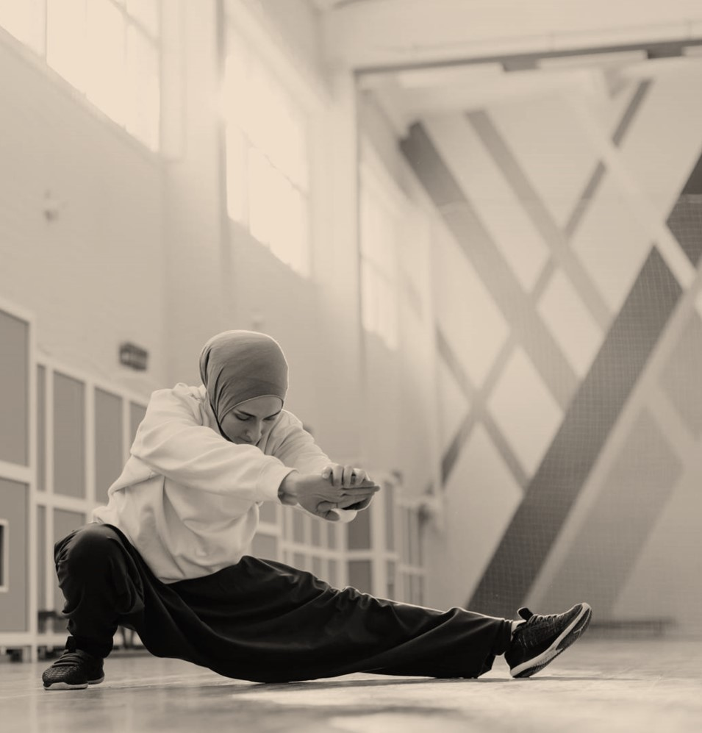
1. Choice of CLIP Model
Reason : CLIP is a state-of-the-art model for multi-modal tasks like text-to-image search. It has been trained on a large dataset of text-image pairs, making it highly effective at understanding semantic relationships between text and images.
Advantages :
Zero-shot capability: No need for fine-tuning or additional training.
High accuracy in matching textual queries to images.

Slide 4
2. Pre-computation of Image Features
Reason : To improve performance, image features are pre-computed and stored in a dictionary (image_features_dict). This avoids redundant computations during runtime.
Trade-offs :
Increased memory usage due to storing feature vectors.
However, this trade-off is acceptable for smaller datasets and ensures faster query processing.

Slide 5
3. Flask Web Framework
Reason : Flask was chosen for its simplicity and ease of integration with Python-based machine learning models.
Advantages :
Lightweight and easy to deploy.
Suitable for small-scale applications and demonstrations.

Slide 6
4. Dataset Limitation
Reason : For demonstration purposes, the dataset is limited to 500 images. This ensures quick loading times and reduces computational overhead during development.
Future Scalability :
For larger datasets, we could implement indexing techniques like FAISS or Annoy for efficient nearest neighbor searches.

Slide 7
5. File Upload and Validation
Reason : The allowed_file function ensures only valid image files (PNG, JPG, JPEG) are processed, preventing errors or security vulnerabilities.

Slide 8

Challenges Faced
1. Memory Constraints
Challenge : Pre-computing and storing image features for a large dataset can consume significant memory.
Solution : Limited the dataset size to 500 images for demonstration. For larger datasets, features could be stored in a database or disk-based storage.
2. Performance Optimization
Challenge : Computing cosine similarities for all images in real-time can be computationally expensive.
Solution : Pre-computed image features and used them directly for comparison, significantly reducing computation time
3. Handling Empty Queries
Challenge : Ensuring the system handles empty or invalid queries gracefully.
Solution : Added validation checks to redirect users back to the homepage if no query is provided.

Slide 9
THANK YOU
Marshall Mulanga Nekhubvi
0730176842
Marshallmulanga@gmail.com

